Slide 1
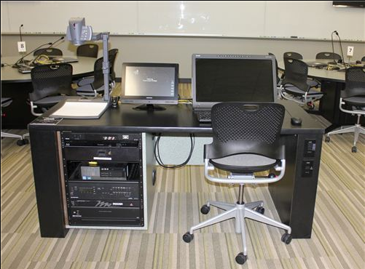
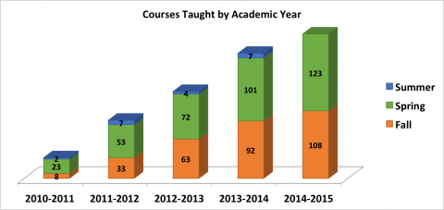
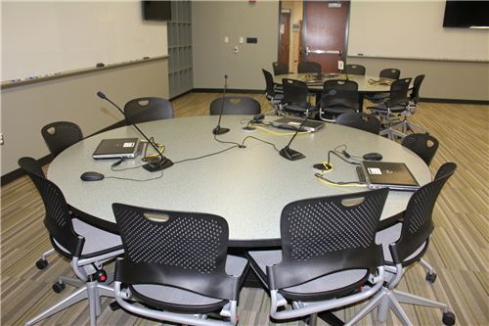
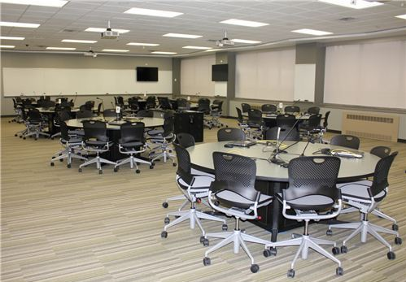
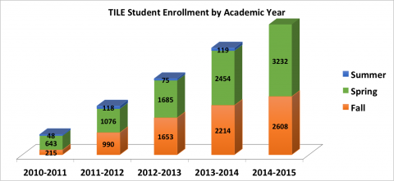
Group-Based Learning in the TILE Environment Kevin Gerstle and Catie Patterson Department of Mathematics, The University of Iowa
Introduction
Our Lesson
The TILE Classroom
At the University of Iowa, the Transform, Interact, Learn, Engage (TILE) Project supports the goal of increasing student success by changing the way the classroom functions. The TILE classroom environment encourages active learning by restructuring the classroom and incorporating technology.
During Spring 2015, we taught the essentials of exponential and logarithmic functions to a pre-calculus class using the TILE environment. We designed our activities around collaborative, guided discovery of the properties of these functions while emphasizing the application of prior knowledge. By adapting our lessons to the TILE environment, we were able to produce a richer educational experience for our students.
For five class periods, we taught our pre-calculus class in the TILE environment. Since the TILE rooms were unavailable during our class period, we converted our regular classroom into a makeshift TILE room.
During our time in this setting, students studied the properties of exponential and logarithmic functions. Rather than traditional lecturing, we instead gave students activities in which they were able to discover these properties themselves.
Summary of Topics:
Introduction to exponential functions
Properties of exponential functions
Solving equations with exponential functions
Graphing exponential functions
Defining the logarithm using the definition of inverse functions
Solving equations using arithmetic properties of the logarithm
Using change of base formulas
Graphing logarithmic functions
Sample In-Class Activity:
Look at your exponential graphs from §5.2. Do these functions have inverses? If so, what should they look like? Sketch the inverses of your functions.
Pick one of your inverse graphs and answer the following questions:
What are the domain and range of the inverse?
What happens as and as ?
What happens as and as ?
What are some key points on the graph of the inverse?
On each wall of a TILE classroom, there are whiteboards, projection screens, and TVs where students can display their work. The instructor’s station lies in the center rather than at the front of the room to reflect the focus on collaborative learning.
Instructor’s station:
Computer
SMART Podium
Document Camera
Round tables with seating for 9 students:
3 laptops per table
1 TV per table
History of TILE
The TILE program was first implemented in Fall 2010 and is based on North Carolina State University’s Student-Centered Activities for Large-Enrollment Undergraduate Programs (SCALE-UP). The TILE program began with three classrooms and eight courses, and it has grown to eight classrooms and 123 courses in Spring 2015.
The two goals on which the student-centered TILE program was founded are:
“Create spaces that support teaching and learning models that lead to increased student recruitment and retention.”
“Make the most effective use of learning spaces available as student enrollment increases and new classroom construction is limited.”
According to a 2010-2012 study:
In Fall 2010, students in four classes conducted in a TILE classroom on average received higher grades than students taking the same courses with the same professors in a traditional classroom.
Positive perceptions towards the use of technology and active participation in class were positively correlated with final grades in TILE courses.
“Students in TILE courses showed a more positive attitude and increased engagement by the end of the course.”
Possible Improvements
While we found it effective to use the TILE methodology in our regular classroom, by using the technology in an official TILE classroom, we could further enrich the learning experience. For instance, students can use software to plot individual points on exponential functions to determine their general shape.
Also, if time allowed, we could include more activities in which students can derive the properties of these functions themselves. As an example, through guided questions, students can themselves discover the arithmetic properties of the logarithm:
Let . What is ?
Simplify your answer from part a) using exponent rules.
You should have an equation for . Solve it for using a logarithm.
Use what you found in part c) to fill in this equation: .
Results
References
Van Horne, S., Murniati, C., Gaffney, J. D. H., & Jesse, M. (2012). Promoting active learning in technology-infused TILE classrooms at the University of Iowa. Journal of Learning Spaces, 1(2), June 10, 2012.
Van Horne, S., Murniati, C., & Saichaie, K. (2012). Assessing teaching and learning in technology-infused TILE classrooms at the University of Iowa. In EDUCAUSE Learning Initiative’s Seeking Evidence of Impact.
http://tile.uiowa.edu/content/about-tile
http://classrooms.uiowa.edu
Notes:
http://tile.uiowa.edu/stats - graphs

